Slide 1

Lecture 8
Inheritance

Slide 2
Inheritance in Java
Inheritance in Java is a mechanism in which one object acquires all the properties and behaviors of a parent object. It is an important part of OOPs (Object Oriented programming system).
The idea behind inheritance in Java is that you can create new classes that are built upon existing classes. When you inherit from an existing class, you can reuse methods and fields of the parent class. Moreover, you can add new methods and fields in your current class also.
Why use inheritance in java
For Method Overriding (so runtime polymorphism can be achieved).
For Code Reusability.

Slide 3
The syntax of Java Inheritance
class Subclass-name extends Superclass-name
{
//methods and fields
}

Slide 4
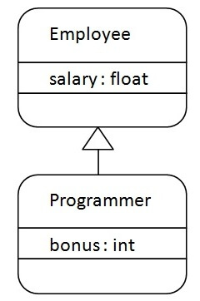
The extends keyword indicates that you are making a new class that derives from an existing class. The meaning of "extends" is to increase the functionality.
In the terminology of Java, a class which is inherited is called a parent or superclass, and the new class is called child or subclass.
Java Inheritance Example

Slide 5
class Employee{
float salary=40000;
}
class Programmer extends Employee{
int bonus=10000;
public static void main(String args[]){
Programmer p=new Programmer();
System.out.println("Programmer salary is:"+p.salary);
System.out.println("Bonus of Programmer is:"+p.bonus);
}
}

Slide 6
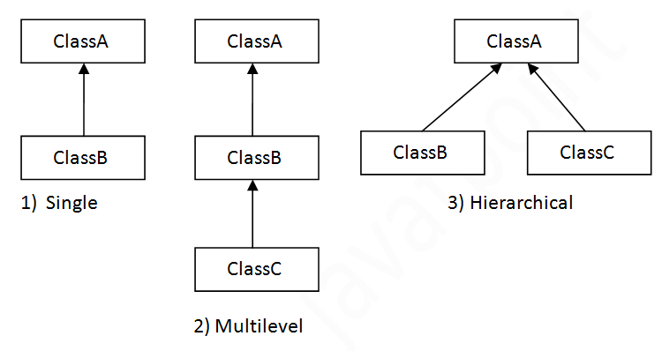
Types of inheritance in java
Note: Multiple inheritance is not supported in Java through class.
On the basis of class, there can be three types of inheritance in java: single, multilevel and hierarchical
In java programming, multiple and hybrid inheritance is supported through interface only. We will learn about interfaces later.

Slide 7
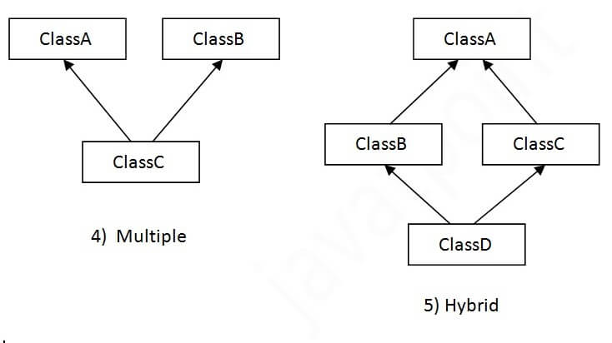

Slide 8
Single Inheritance Example
When a class inherits another class, it is known as a single inheritance. In the example given below, Dog class inherits the Animal class, so there is the single inheritance.
class Animal{
void eat(){System.out.println("eating...");}
}
class Dog extends Animal{
void bark(){System.out.println("barking...");}
}
class TestInheritance{
public static void main(String args[]){
Dog d=new Dog();
d.bark();
d.eat();
}}
https://ide.geeksforgeeks.org/e6ca7b35-d252-4f1c-b3d0-991f4f361467

Slide 9
Multilevel Inheritance Example
class Animal{
void eat(){System.out.println("eating...");}
}
class Dog extends Animal{
void bark(){System.out.println("barking...");}
}
class BabyDog extends Dog{
void weep(){System.out.println("weeping...");}
}
class TestInheritance2{
public static void main(String args[]){
BabyDog d=new BabyDog();
d.weep();
d.bark();
d.eat();
}}
https://ide.geeksforgeeks.org/a07ecef5-60a9-456c-9a77-42f07aecf77e

Slide 10
Hierarchical Inheritance Example
When two or more classes inherits a single class, it is known as hierarchical inheritance. In the example given below, Dog and Cat classes inherits the Animal class, so there is hierarchical inheritance.
class Animal{
void eat(){System.out.println("eating...");}
}
class Dog extends Animal{
void bark(){System.out.println("barking...");}
}
class Cat extends Animal{
void meow(){System.out.println("meowing...");}
}
class TestInheritance3{
public static void main(String args[]){
Cat c=new Cat();
c.meow();
c.eat();
//c.bark();//C.T.Error
}}
https://ide.geeksforgeeks.org/afae5eae-7773-4c12-98f4-b49e42db3777

Slide 11
Q) Why multiple inheritance is not supported in java?
class A{
void msg(){System.out.println("Hello");}
}
class B{
void msg(){System.out.println("Welcome");}
}
class C extends A,B{//suppose if it were
public static void main(String args[]){
C obj=new C();
obj.msg();//Now which msg() method would be invoked?
}
}

Slide 12
Multiple inheritance by Interface in Java
interface AnimalEat {
void eat();
}
interface AnimalTravel {
void travel();
}
class Animal implements AnimalEat, AnimalTravel {
public void eat() {
System.out.println("Animal is eating");
}
public void travel() {
System.out.println("Animal is travelling");
}
}
public class Demo {
public static void main(String args[]) {
Animal a = new Animal();
a.eat();
a.travel();
}
}

Slide 13
What is Diamond Problem in Java
InterfaceName.super.methodName();
https://ide.geeksforgeeks.org/1880a859-e415-4b76-a09e-ca753f5e8636
https://ide.geeksforgeeks.org/50a5013f-33b7-454f-90db-f099aec11a5c

